Slide 1

A Brief Review of CIMI Progress, Plans, and Goals
Joint CIMI and SemanticHealthNet Meeting
Brussels, Belgium
March 13, 2014
Stanley M Huff, MD
Chief Medical Informatics Officer

Slide 2
CIMI Executive Committee
Stan Huff
Virginia Riehl
Nicholas Oughtibridge
Jamie Ferguson
Jane Millar
Tom Jones
Colleen Brooks

Slide 3
CIMI Modeling Taskforce
Linda Bird
Harold Solbrig
Thomas Beale
Gerard Freriks
Michael van der Zel
Rahil Siddiqui
Daniel Karlson
Stephen Chu
Mark Shafarman
Galen Mulroney
Sarah Ryan
David Karlson
Heather Leslie
Ian McNicoll
Michael Lincoln
Anneke Goossen
William Goossen
Jay Lyle
Josh Mandel
Grahame Grieve
Dipak Kalra
Cecil Lynch
David Moner
Peter Hendler

Slide 4
Intermountain’s Motivation for CIMI

Slide 5
The Ultimate Value Proposition of CIMI
Interoperable sharing of:
Data
Information
Applications
Decision logic
Reports
Knowledge

Slide 6
Patient

Slide 7
Core Assumptions
‘The complexity of modern medicine exceeds the inherent limitations of the unaided human mind.’
~ David M. Eddy, MD, Ph.D.
‘... man is not perfectible. There are limits to man’s capabilities as an information processor that assure the occurrence of random errors in his activities.’
~ Clement J. McDonald, MD

Slide 8
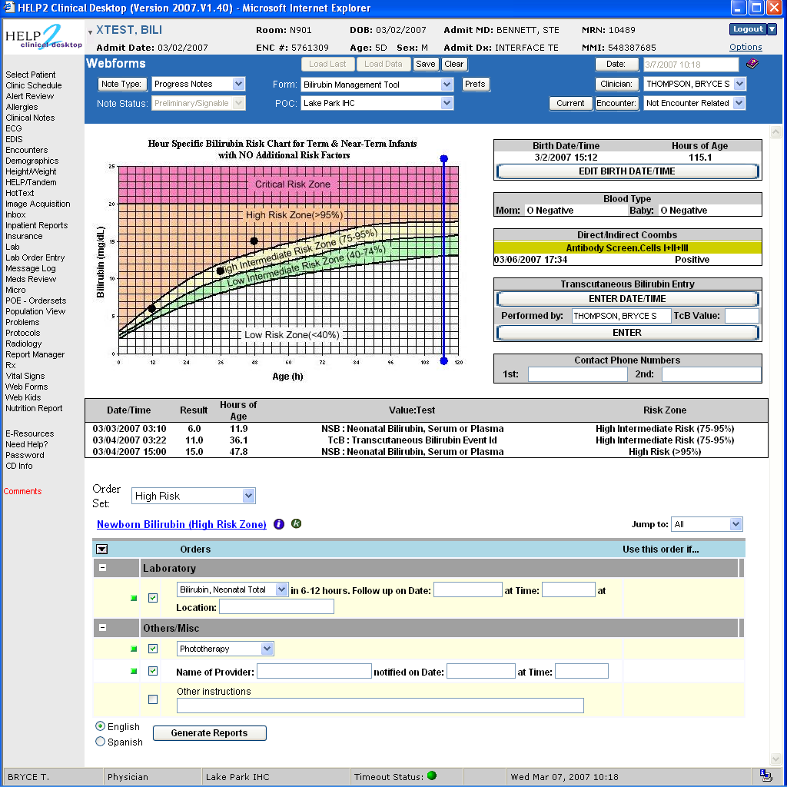

Slide 9
Newborns w/ hyperbilirubinemia

Slide 10
Clinical System Approach
Intermountain can only provide the highest quality, lowest cost health care with the use of advanced clinical decision support systems integrated into frontline clinical workflow

Slide 11
Decision Support Modules
Antibiotic Assistant
Ventilator weaning
ARDS protocols
Nosocomial infection monitoring
MRSA monitoring and control
Prevention of Deep Venous Thrombosis
Infectious disease reporting to public health
Diabetic care
Pre-op antibiotics
ICU glucose protocols
Ventilator disconnect
Infusion pump errors
Lab alerts
Blood ordering
Order sets
Patient worksheets
Post MI discharge meds

Slide 12
Strategic Goal
Be able to share data, applications, reports, alerts, protocols, and decision support modules with anyone in the WORLD
Goal is “plug-n-play” interoperability

Slide 13
5 Layer Architecture (from Catalina MARTÍNEZ-COSTA, Dipak KALRA, Stefan SCHULZ)
Vendor
Work

Slide 14
SMART on FHIR – Architecture (from David McCallie)
Web
App Servers
Trusted
Applications
Registry
SOA-like API
(FHIR)
Blue Button
Pull
(mHealth)
FHIR
HTML5
HTTPS or SOAP
FHIR / HTTPS
FHIR
SMART
App
SMART
App
Open Platform Services
FHIR + CEM + OAuth2
SMART Container
(HTML - MPage)
Transport → FHIR / HTTPS
CEMs → FHIR Profiles
UX → SMART App Platform
Mobile Apps → BB-Pull
SOA-like API → FHIR + ?
Security → OAuth2
EHR Platform

Slide 15
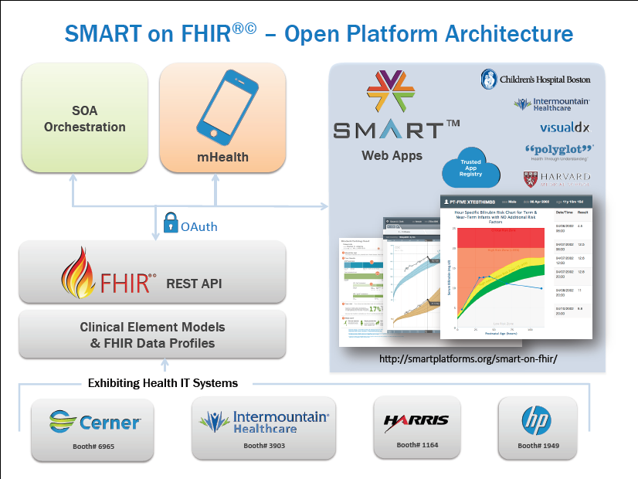

Slide 16
CIMI Vision, Mission, and Goals

Slide 17
What Is Needed to Create a New Paradigm?
Standard set of detailed clinical data models coupled with…
Standard coded terminology
Standard API’s (Application Programmer Interfaces) for healthcare related services
Open sharing of models, coded terms, and API’s
Sharing of decision logic and applications

Slide 18
Clinical modeling activities
Netherlands/ISO Standard
ISO EN 13606
UK – NHS and LRA
Singapore
Sweden
Australia
openEHR Foundation
Canada
US Veterans Administration
US Department of Defense
Intermountain Healthcare
Mayo Clinic
MLHIM
Others….
SemanticHealthNet
HL7
Version 3 RIM, message templates
TermInfo
CDA plus Templates
Detailed Clinical Models
greenCDA
Tolven
NIH/NCI – Common Data Elements, CaBIG
CDISC SHARE
Korea
Brazil

Slide 19
Clinical Information Modeling Initiative
Mission
Improve the interoperability of healthcare systems through shared implementable clinical information models.
(A single curated collection.)

Slide 20
Clinical Information Modeling Initiative
Goals
Shared repository of detailed clinical information models
Using a single formalism (now support two!)
Based on a common set of base data types
With formal bindings of the models to standard coded terminologies
Repository is open and models are free for use at no cost

Slide 21
Goal: Models that support multiple contexts
EHR data storage
Message payload and service payload
Decision logic (queries of EHR data)
Clinical trials data (clinical research)
Quality measures
Normalization of data for secondary use
Creation of data entry screens (like SDC)
Capture of coding output from NLP

Slide 22
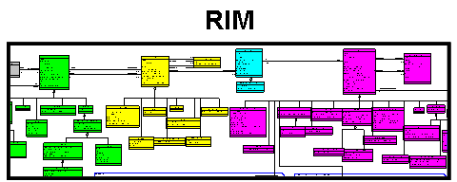
Information Model Ideas
Standard
Terminologies
And Ontologies
CEM
V2 “|”
LRA
V2 XML
HTML
CEMs
V3 XML
DCMs
FHIR
Repository of Shared
Models in
an approved Formalism
Translators
Realm
Specific Specializations
Translators
AML
Realm
Specific Specializations
Translators
CDA
Templates
Realm
Specific Specializations
Realm
Specific Specializations
Localization and Context Specialization
ADL
openEHR
Archetypes
CDA
OWL
ISO EN 13606
Archetypes
LRA
Models
CDISC
SHARE
SOA
Payload
FHIR
Resources
CEN
Archetype
Initial Loading of Repository

Slide 23
Roadmap (some parallel activities)
Choose supported formalism(s)
Define the core reference model, including data types (leaf types)
Define our modeling style and approach
Patterns
Development of “style” will continue as we begin creating content

Slide 24
Roadmap (continued)
Create an open shared repository of models
Requirements
Find a place to host the repository
Select or develop the model repository software
Create model content in the repository
Start with existing content that participants can contribute
Must engage clinical experts for validation of the models

Slide 25
Roadmap (continued)
Create a process (editorial board?) for curation and management of model content
Resolve and specify IP policies for open sharing of models
Find a way of funding and supporting the repository and modeling activities
Create tools/compilers/transformers to other formalisms
Must support at least ADL, UML/OCL, Semantic Web, HL7
Create tools/compilers/transformers to create what software developers need (joint work)
Examples: XML schema, Java classes, CDA templates, greenCDA, RFH, SMART RDF, etc.

Slide 26
Modeling at Intermountain
1994 – Models using Abstract Syntax Notation 1 (ASN.1)
~ 2000 – attempt modeling with XML Schema
No terminology binding capabilities, no constraint language
2004 – models using Clinical Element Modeling Language (CEML), 5000+ models
2009 – models converted to Constraint Definition Language (CDL)
2013 – models converted back to CEML
2014 – models in ADL, and FHIR profiles

Slide 27
Intermountain Plans
Continue to use CEML internally for now
Intermountain models are available at
www.clinicalelement.com
Translate CEML models to ADL 1.5
Contribute converted models to CIMI
Place models in the CIMI repository with “proposed status”
Models reviewed and modified to conform to CIMI standards and style

Slide 28
Selected CIMI Policies, Decisions, and Milestones

Slide 29
Decisions (London, Dec 1, 2011)
We agreed to:
ADL 1.5 as the initial formalism, including the Archetype Object Model
A CIMI UML profile (Archetype Modelling Language, AML) will be developed concurrently as a set of UML stereotypes, XMI specifications and transformations

Slide 30
Definition of “Logical Model”
Models show the structural relationship of the model elements (containment)
Coded elements have explicit binding to allowed coded values
Models are independent of a specific programming language or type of database
Support explicit, unambiguous query statements against data instances

Slide 31
Implementation Strategy
As needed, we will make official mappings from the CIMI logical models to particular implementations (logical data types -> physical data types)
FHIR
CCDA
HL7 V3 messaging
Etc.

Slide 32
Further modeling decisions
One or more Examples of instance data will be created for each model
The examples can show both proper and improper use
Models shall specify a single preferred unit of measure (unit normalization)
Models can support inclusion of processing knowledge (default values)

Slide 33
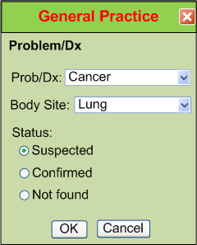
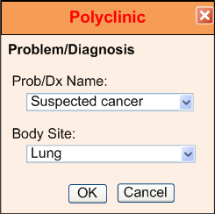
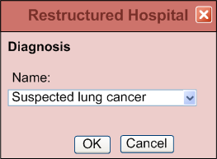
IsoSemantic Models – Example of Problem (from Dr. Linda Bird)
e.g. “Suspected Lung Cancer”

Slide 34
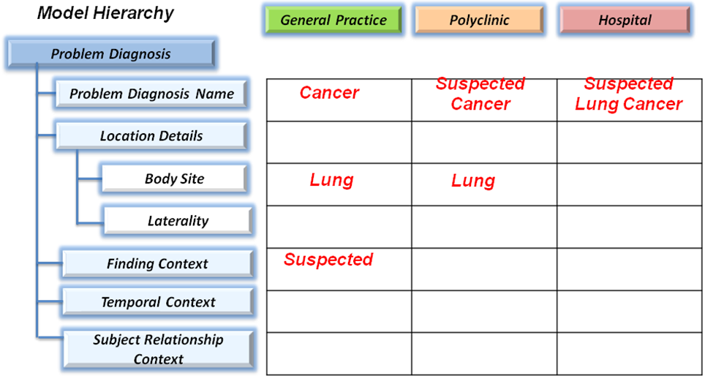
IsoSemantic Models – Example Instances (from Dr. Linda Bird)
e.g. “Suspected Lung Cancer”

Slide 35
Isosemantic Models
CIMI supports isosemantic clinical models:
We will keep isosemantic models in the CIMI repository that use a different split between pre-coordination versus post coordination (different split between terminology and information model)
One model in an isosemantic family will be selected as the preferred model for interoperability (as opposed to everyone supporting every model)
Profiles of models for specific use cases will be created by authoritative bodies: professional societies, regulatory agencies, public health, quality measures, etc.)

Slide 36
Terminology
SNOMED CT is the primary reference terminology
LOINC is also approved as a reference terminology
In the event of overlap, SNOMED CT will be the preferred source
CIMI will propose extensions to the reference terminologies when needed concepts do not exist
CIMI will have a place to keep needed concepts that are not a part of any standard terminology
CIMI has obtained a SNOMED extension identifier
CIMI will adhere to IHTSDO Affiliate’s Agreement for referencing SNOMED codes in models
Copyright notice in models, SNOMED license for all production implementations
CIMI will create a Terminology Authority to review and submit concepts to IHTSDO as appropriate

Slide 37
Terminology (cont)
The primary version of models will only contain references (pointers) to value sets
We will create tools that read the terminology tables and create versions of the models that contain enumerated value sets (as in the current ADL 1.5 specification)

Slide 38
March 29, 2012 – Semantic Interoperability
CIMI models must be capable of supporting semantic interoperability across a federation of enterprises
We will define the relationship between each parent and child node in the hierarchy
SNOMED relationship concepts will be used to define the parent-child relationships in the models
Goal: Enable use of the SNOMED CT concept model to support translation of data from pre coordinated to post coordinated representations

Slide 39
Content Ownership and Intellectual Property
Those who contribute models to CIMI will retain ownership and the IP of the models, but they grant CIMI a license to use the model content at no cost in perpetuity and to allow CIMI to sublicense the use of the models at no cost to those who use the models

Slide 40
Leeds – CIMI Website
The group accepted a proposal from Portavita to provide a CIMI website. The website would:
Provide descriptive, historical, and tutorial kinds of information about CIMI
Act as a distribution site for CIMI models and other CIMI artifacts (MimdMaps, Tree Display, Examples)

Slide 41
Leeds – Editorial Board
The requirements for approval of CIMI content will be developed and approved by the usual CIMI work processes (and not by the EB)
Style guide and related policies
The EB has the responsibility to document the process for approving official CIMI content
The EB approves roles and access permissions for specific individuals relative to management of the CIMI repository
The EB ensures that approved processes are followed, and reports regularly to the EC

Slide 42
http://www.clinicalelement.com/cimi-browser/
First draft CIMI models now available:

Slide 43
Some Principles
CIMI DOES care about implementation. There must be at least one way to implement the models in a popular technology stack that is in use today. The models should be as easy to implement as possible.
Only use will determine if we are producing anything of value
Approve “Good Enough” RM and DTs
Get practical use ASAP
Change RM and DTs based on use

Slide 44
Primary Near Term Goals
As soon as possible, make some high quality CIMI models available in a web accessible repository
ADL 1.5 (AOM framework) and/or UML (AML, XMI)
That use the CIMI reference model
That have complete terminology bindings
Get the models used in someone’s working system
Document our experience
Improve our processes and models
Repeat!

Slide 45
Current Issues and Work Items
Finalize the approach for modeling panels
The question of “Entries in entries”
Finalize terminology binding syntax and policies
Approach to creating examples of data instances
Further specification of standards for graphical representation of the models
Progress on Archetype Modeling Language
Continue modeling work
Progress on CIMI website

Slide 46
Possible Topics for Discussion

Slide 47
Relation of CIMI to other Initiatives
HL7 RIM
US FHIM
UK LRA
LEGOs
openEHR
ISO EN 13606
CDA and CCDA
IHTSDO
FHIR
Quality models
SMART
SHARP
HL7 CDS VMR

Slide 48
Possible Issues for Discussion
CIMI reference model
Data types
URIs for coded items
Simplifications
“Entries in entries” question
Modeling “style” – use of patterns
Supporting multiple contexts of use
Terminology binding
“Relationship” bindings
HL7 binding capabilities – static/dynamic, strong/weak
The essential need for instance examples
Isosemantic models
Standardization of graphical representations
Alignment with HL7 FHIR

